Slide 1
Data Base Management System (DBMS) Unit -1

Slide 2
Data Base Management System
Data: Data is the basic raw facts and figures
Ex: a name, a digit, a picture etc.
Data Base: Collection of related data
Ex. the names, telephone numbers and addresses of all the people you know
Data Base Management System:
A DBMS is a set of programs that controls creation, storage, management, and retrieval of data in a database.
Ex: MS-Access, Oracle, MY SQL, Sybase, IBM DB2, Ingres etc

Slide 3
Use of DBMS
Corporate
Airlines
Hotels
Banks
Colleges /University
Railway reservation
Telecommunication Industry
Data mining
Libraries

Slide 4
Disadvantages of Flat File Systems
No centralized control
Data Redundancy
Data Inconsistency
Data can not be shared
Standards can not be enforced
Security issues
Integrity can not be maintained
Data Dependence

Slide 5
Advantages of Using DBMS
No Data Redundancy
Data Consistency
Mass Data Storage
Centralized Access
Automatic Backup Possible
Data Recovery Possible
Integrity Constraints
Easy updation & fetching of data
Only authorized Access

Slide 6
Data Base Characteristics
Controls data redundancy.
Enforces user defined rules.
Ensures data sharing.
It has automatic and intelligent backup and recovery procedures.
It has central dictionary to store information pertaining to data and its manipulation.
It has different interfaces via which user can manipulate the data.
Enforces data access authorization.
Represents complex relationship between data.

Slide 7
Classification of DBMS
Relational DBMS:
Modeling concept: tables and constraints on tables
Query Language: SQL
Applications: suited for traditional business processing
Object-Oriented DBMS
Modeling concepts: objects, classes, inheritance
Query Language: object oriented OQL
Applications: suited for CAD databases, CASE databases, office automation
Object-Relational DBMS:
Incorporate OO concepts into relational model
Similar functionality as OO-DBMS, but different implementations
Language: extended to process objects. Eg: Cloudscape, DB2

Slide 8
DBMS Overview
user
Applications/queries
Query processor
Storage manager
metadata
data
Database: collection of interrelated information about world being modeled
DBMS: general-purpose software to define, create, modify, retrieve, delete and manipulate a database

Slide 9
Data Base Users
DBMS designers and implementers
Database administrator (DBA)
“superuser” of a database, similar to a system administrator.
Define schemas, views, authorization, indexes, tuning parameters, etc.
Application programmers
End users

Slide 10
Roles of Data Base Administrator
A database administrator (DBA) is a person responsible for the design, implementation, maintenance and repair of an organization's database. The key roles of a DBA are :
To Provide space to each user.
To create the external and logical Schema.
To Provide security from unauthorized access.
To grant permissions to the user
Installation, configuration and upgrading of DBMS server software and related products.
To take Back up and Recovery of data.
Performance monitoring of the machine and database.

Slide 11


Data Abstraction
Hiding system complexity and physical storage details from users and applications
Customized view
(External level)
View1
View 2
View n
Conceptual representation
Logical Level
Physical data description
(Internal level)
Physical level

Slide 12
Three-Layer Abstraction
External Schema - 1
External Schema - 2
External Schema - 3
Conceptual Schema
Physical Schema
Disk

Slide 13
Description of Levels
Users Level:
Any number of users may exists in this view.
Different users may have different external views for the same data.
It insulates the users from the details of internal & conceptual level.
Conceptual Level:
This level is designed by data base administrator.
Under this level a schema of data base is created by DBA.
It represents the entire database and there can be only one conceptual view per database.
It represents entities, their attributes and relationships between them.
It is independent on the hardware and software.
This is also known as Logical Level.
Internal Level:
It indicates how the data will be stored ad describes the data structures and access methods to be used by data base (ie. The physical implementation of data).
It is concerned with storage space allocation, indexes, data compression etc.

Slide 14
Data Independence
When a schema at a lower level is changed, only the mappings between this schema and higher-lever schemas need to be changed in a DBMS that fully supports data independence.
The higher-level schemas themselves are unchanged. Hence, the application programs need not be changed since they refer to the external schemas.
Disadvantages of two levels of mappings: Overhead during compilation or execution of a query or program

Slide 15
Data Independence
Logical Data Independence: The capacity to change the conceptual schema without having to change the external schemas and their
application programs.
Example : Addition or removal of new entities, attributes, relationships etc to the conceptual schema should be possible without affecting existing external schema.
Physical Data Independence: The capacity to change the internal schema without having to change the conceptual schema.
Example:
Using new storage devices, different data structures, different access methods, different file organization or storage structures and modifying indexes.

Slide 16
Mapping between views
Two mappings are required in a database system with three different views:
Mapping between conceptual and external view
Mapping between internal and conceptual view
Mapping between views specifies the methods of deriving the record at one level from the record at lower level.

Slide 17
DBMS Interface
Provides users means to interact with database:
Menu driven interface
Forms based interface
Using SQL
WWW connectivity.

Slide 18
DBMS Languages
Data Definition Language (DDL)
Used to describe a schema
Eg: Create table, drop table, alter table etc
Data Manipulation Language (DML)
Used by users to query the DB and change the data
Eg: Insert into, update, delete etc
Data Control Language (DCL)
Used to specify access control on data
Eg: Grant, Revoke etc
View Definition Language (VDL)
Define views
Eg: Create view etc

Slide 19
Data Model
Concepts and tools used to describe DB schemas
A Data Model is a mechanism that provides abstraction for database applications. Different models provide different abstraction levels
Data modeling is used for representing entities of interest and their relationships in the database.
It allows the conceptualization of the association between various entities and their attributes.

Slide 20
Data Model Classification
Flat file (Primitive model)
Traditional Models
Hierarchical Data Model
Network Data model
Relational Data model
Object Based Models
Entity-Relationship Model
Object- Oriented Models
Semi structured Data Model

Slide 21
Features of Flat Files
A flat file database is a type of database that stores data in a single table or a file. Placing data in a flat file offers following advantages:
All records are stored at one place
Easy to set up using different office applications
Easy to understand
Records can be viewed or extracted based on simple criteria

Slide 22
Disadvantages of flat files
Potential duplication
Data Inconsistency
No centralized access
Harder to change data format
Poor at complex queries
Poor at authorized access

Slide 23
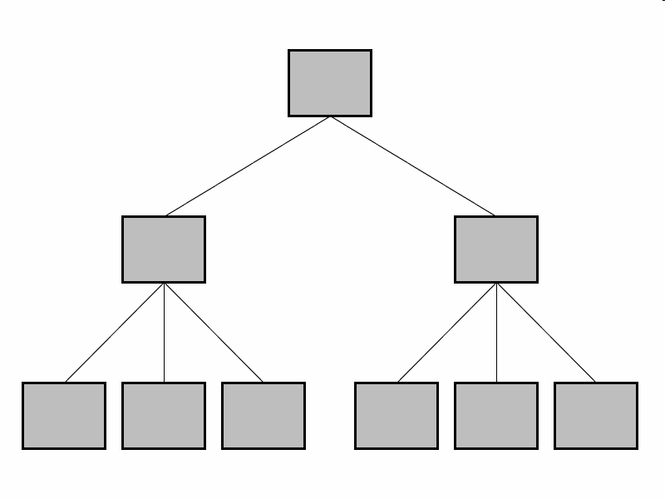
Hierarchical Data Model
In this model data is organized into a tree-like structure, implying a single upward link in each record to describe the nesting, and a sort field to keep the records in a particular order in each same-level list.

Slide 24
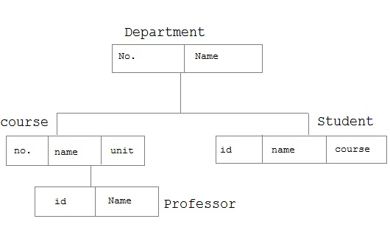

Slide 25
Drawbacks: Hierarchical DBMS
Can not handle Many-Many relationships.
Can not reflect all real life situations
Difficult to perform insert, delete and update operations.

Slide 26
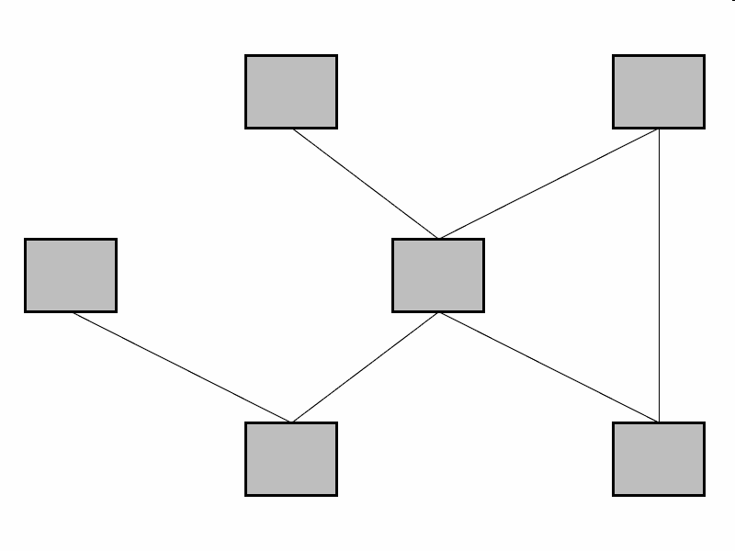
Network Data Model
In the network model, entities are organised in a graph in which some entities can be accessed through several path.
The basic data modeling construct in the network model is the set construct. A set consists of an owner record type, a set name, and a member record type. A member record type can have that role in more than one set, hence the multi-parent concept is supported. An owner record type can also be a member or owner in another set.

Slide 27
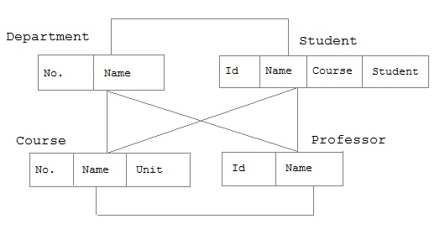

Slide 28
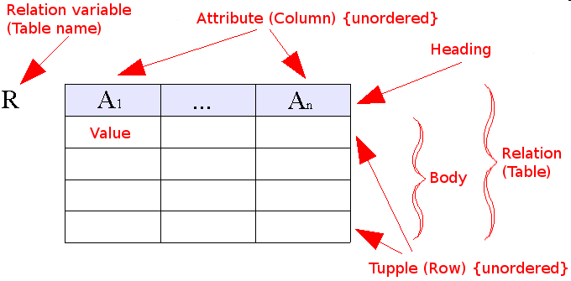
Relational Data Model
Relational model is based on relations construct.
It is bounded with 12 codd ’s rules.
Every information is stored in the form of columns and rows.

Slide 29
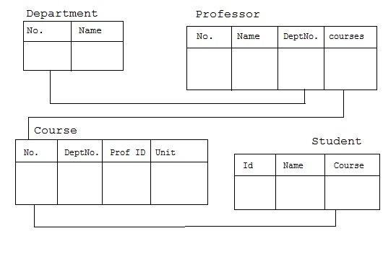

Slide 30
Relational Data Model
Example of tabular data in the relational model
Attributes
Customer-id
customer-
name
customer-
street
customer-
city
account-
number
192-83-7465
019-28-3746
192-83-7465
321-12-3123
019-28-3746
Johnson
Smith
Johnson
Jones
Smith
Alma
North
Alma
Main
North
Palo Alto
Rye
Palo Alto
Harrison
Rye
A-101
A-215
A-201
A-217
A-201

Slide 31
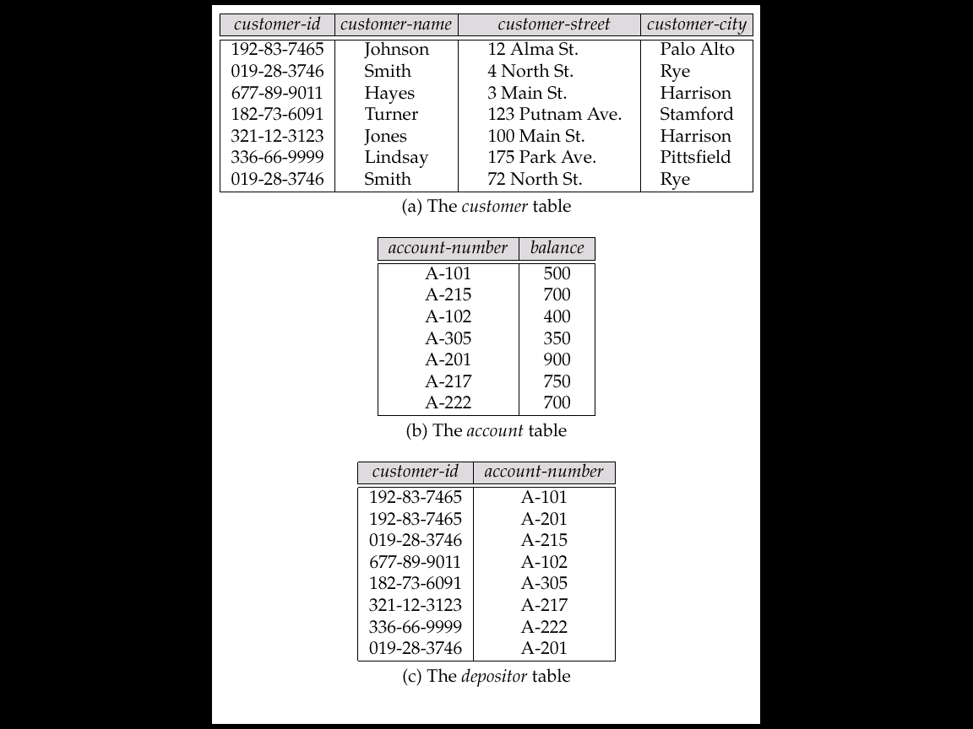
Sample Relational Database

Slide 32
Instance
The collection of information stored in the database at a particular moment is called an instance of the database.
Ex: Amit, 101 etc.

Slide 33
Schema
The overall design of the database is called the database schema.
A schema is the structure of the table which is decided before storing the data.
Example:
Create table student
( rollno number(5),
name char(15),
address varchar2(25));

Slide 34
Tuple
A tuple is a related record stored in a row of the table.
Ex: 101,Alok,MCA,85%
Tuple : Record
Attributes: columns
Entity : Tables

Slide 35
Semi-Structured Data Model
Semi structured data model is a self describing data model, in this the information that is normally associated with a scheme is contained within the data and this property is called as the self describing property.
In such database there is no clear separation between the data and the schema, and the degree to which it is structured depends on the application. In some forms of semistructured data there is no separate schema, in others it exists but only places loose constraints on the data.
Semistructured data has recently emerged as an important topic of study for a variety of reasons. First, there are data sources such as the Web, which we would like to treat as databases but which cannot be constrained by a schema. Second, it may be desirable to have an extremely flexible format for data exchange between disparate databases.

Slide 36
Object Based Models
It is designed using the entities in the real world, attributes of each entity and their relationship. It picks up each thing/object in the real world which is involved in the requirement.
There are two types of object based data Models – Entity Relationship Model and Object oriented data model.
ER data model is one of the important data model which forms the basis for the all the designs in the database world. It defines the mapping between the entities in the database.
Object oriented data model, along with the mapping between the entities, describes the state of each entity and the tasks performed by them.

Slide 37
Object-Oriented Model
This data model is another method of representing real world objects. It considers each object in the world as objects and isolates it from each other. It groups its related functionalities together and allows inheriting its functionality to other related sub-groups.
Let us consider an Employee database to understand this model better. In this database we have different types of employees – Engineer, Accountant, Manager, Clark. But all these employees belong to Person group. Person can have different attributes like name, address, age and phone

Slide 38
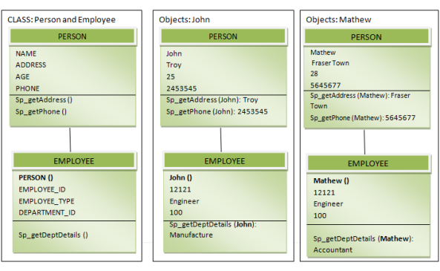

Slide 39
Advantages
Because of its inheritance property, we can re-use the attributes and functionalities. It reduces the cost of maintaining the same data multiple times. Also, these informations are encapsulated and, there is no fear being misused by other objects. If we need any new feature we can easily add new class inherited from parent class and adds new features. Hence it reduces the overhead and maintenance costs.
Because of the above feature, it becomes more flexible in the case of any changes.
Codes are re-used because of inheritance.
Since each class binds its attributes and its functionality, it is same as representing the real world object. We can see each object as a real entity. Hence it is more understandable.
Disadvantages
It is not widely developed and complete to use it in the database systems. Hence it is not accepted by the users.

Slide 40
Entity/Relationship (E/R) Model
Entities: objects
Relationships: associate entities
Roles of entities in a relationship
Constraints on entities:
domain constraints
key constraints
Constraints on relationships:
Cardinality constraints
Participation constraints
Weak Entity Sets
Multiway relationships
Subclass/superclass Relationships
Aggregation

Slide 41
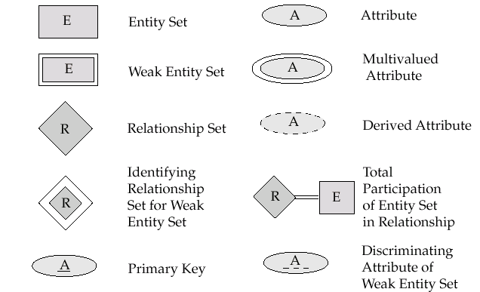
Symbols Used in E-R Notation

Slide 42
Entities and Entity Sets
name
street
number
city
balance
id
Customer
custacct
Account
Entities:
nouns, “things” in the world
Have attributes: course name, id, address, dept, age, room, …
Entity sets: a set of entities

Slide 43
Attributes
Single-valued versus multi-valued:
“telephone number”: multi-valued
“Salary”: single-valued
Atomic versus composite:
“Age”: atomic
“Address”: composite
Derived versus stored:
Derived: derived from other attributes or entities, e.g., “age” derived from “date of birth.”
Stored: all other attributes

Slide 44
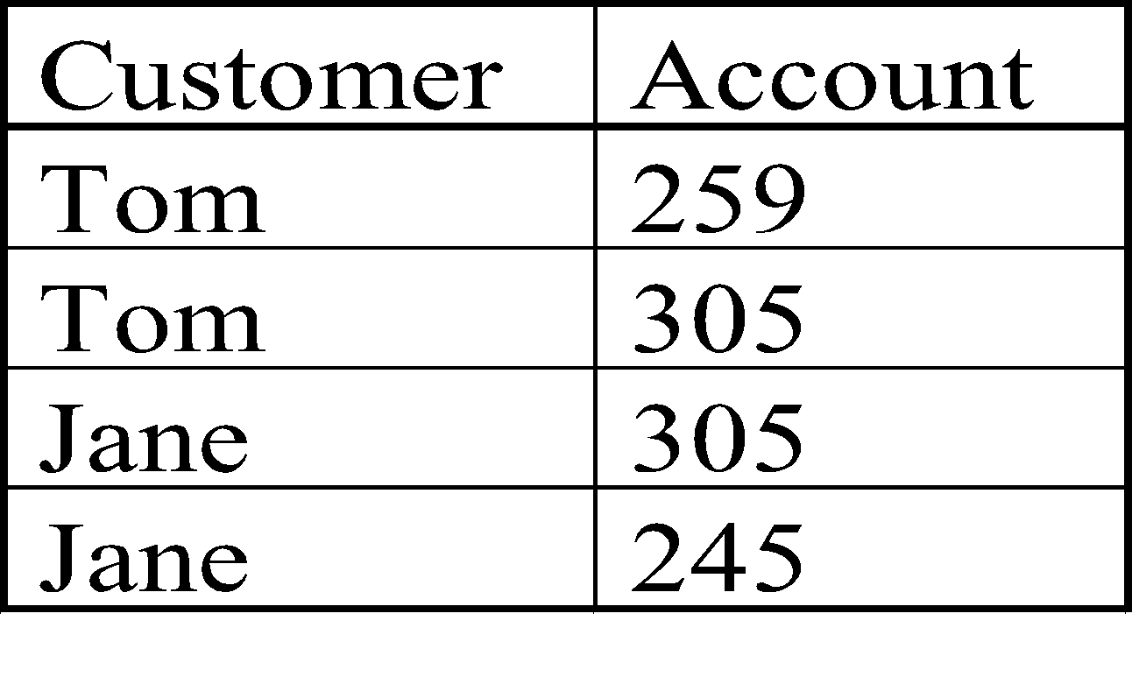
Relationships
Relationship: association of multiple entities
Relationship Set:
set of relationships over the same entity sets
binary, ternary, 4-nary, …n-nary
Custom-Account
Relationship set
account
customer
259, 10K
Tom, 62900, Main, LA
Jane, 62901, North, Irvine
305, 20K
245, 2400
Visualizing relationships as a table. Each row: pair of entities participating in the relationship

Slide 45
ER Diagram
id
name
street
city
balance
number
age
Customer
custacct
Account
dob
tel
opendate
Graphical representation of ER schema. Put as much information as possible.
Entity set: rectangle
Attribute: ellipse
Derived attribute: dashed ellipse (“age”)
Multivalued attribute: double ellipse (“tel”)
Relationship set: diamond, with lines connected to its entity sets. May have attributes, called “relationship attributes.”
Not specified how to represent a composite attribute.

Slide 46
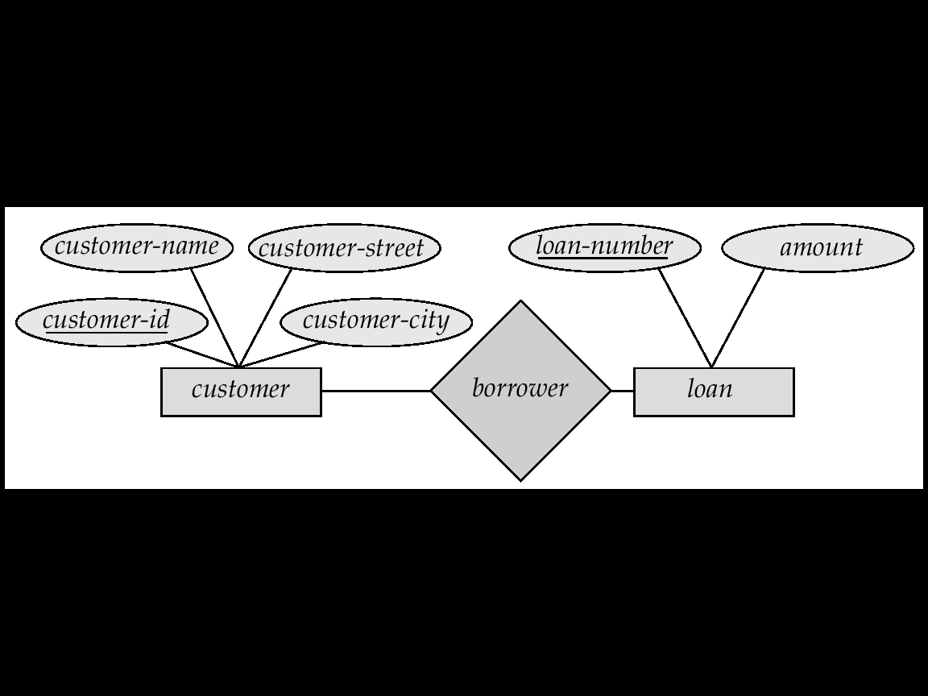
E-R Diagrams
Rectangles represent entity sets.
Diamonds represent relationship sets.
Lines link attributes to entity sets and entity sets to relationship sets.
Ellipses represent attributes
Double ellipses represent multivalued attributes.
Dashed ellipses denote derived attributes.
Underline indicates primary key attributes (will study later)

Slide 47
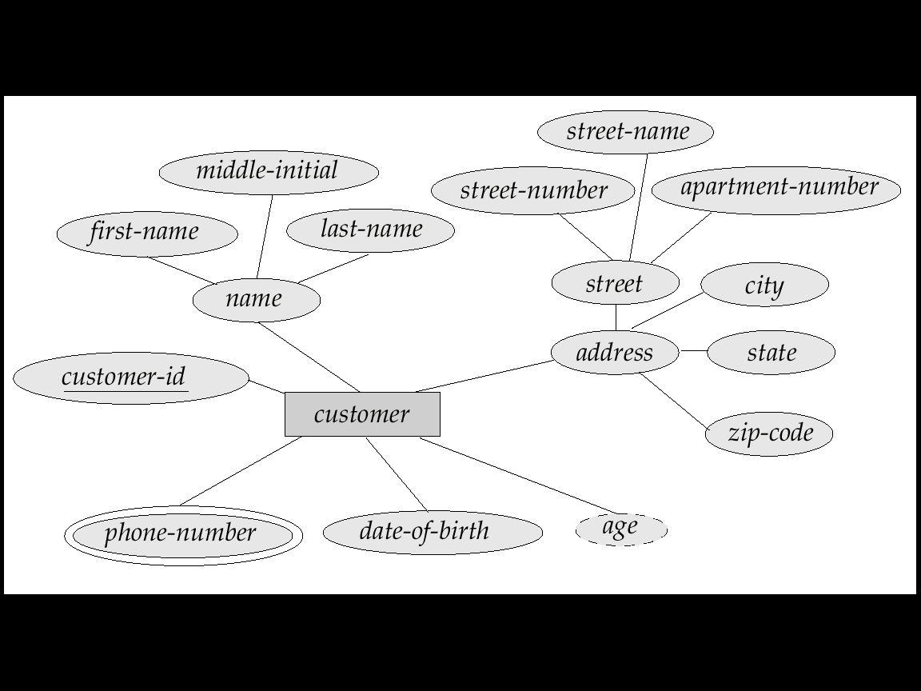
E-R Diagram With Composite, Multivalued, and Derived Attributes

Slide 48
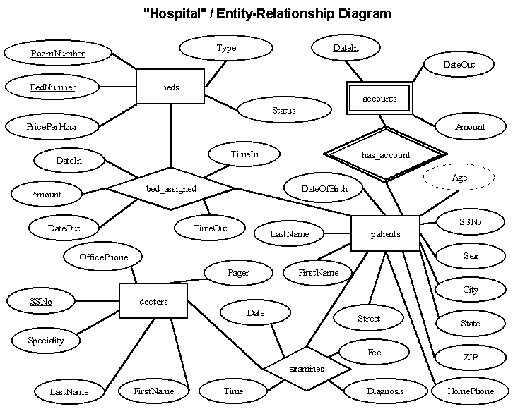
E-R Diagram for Hospital Management System

Slide 49
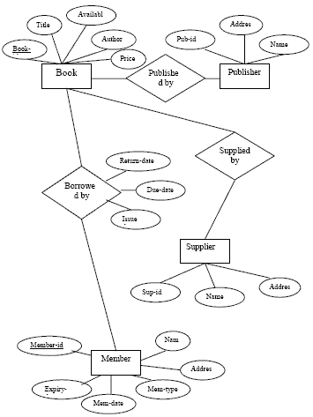
ER Diagram for Library Management System

Slide 50
Types of Keys
Super Key is defined as a set of attributes within a table that uniquely identifies each record within a table. Super Key is a superset of Candidate key.
Candidate Key are minimal superkeys in an entity, one of those keys is selected to be the primary key.
Primary Key is a candidate key that is chosen to uniquely identify entities within an entity set like: rollno
Foreign Key is an attribute in an another relation schema whose values are derived from the primary key of base relation.
Composite key - Key that consist of two or more attributes that uniquely identify an entity occurance is called Composite key. But any attribute that makes up the Composite key is not a simple key in its own.
Secondary key or Alternate Key - The candidate key which are not selected for primary key are known as secondary keys or alternative keys

Slide 51
Roles in a Relationship
Role: the function that an entity plays in a relationship
Needed when entity set is related to itself via a relationship.
manager
employee
works for
worker

Slide 52
Key Constraints on Entity Sets
Associate each entity set with a “key,” which is set of attributes that uniquely identify an entity in entity set.
In ER diagram: denoted by underlining the attributes
Multiple keys possible:
One primary key is chosen and underlined.
Other keys, called secondary keys, either not indicated or listed in a side comment attached to the diagram.
dept
name
number
balance
course
student
Account
No two accounts have the same number.
No two students have the same
name in the same dept.

Slide 53
Cardinality Constraints
A
B
A
B
A
B
Many-to-many
Many-to-one
One-to-one
Multiplicity of binary relationship set R between entity sets A and B
Example: For “One-to-one,” an entity in A is associated with at most one entity in B, and vice versa.

Slide 54
Data Association
Associations exist between different attributes of an entity.
An association between two attributes indicates that the values of the associated attributes are interdependent.
Relationship exists between entities (Binary Relationship)
A possible relationship that may exist between any two sets may be -
one-to-one
one-to-many
many-to-many

Slide 55
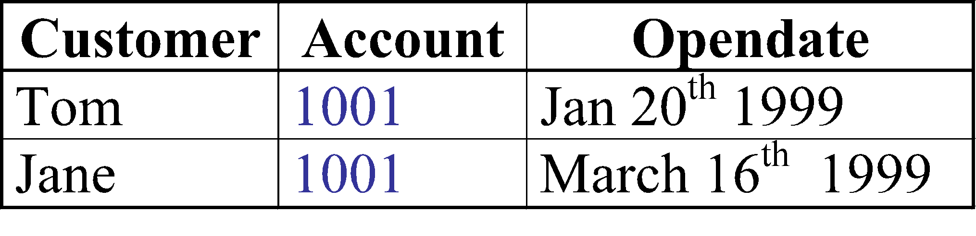
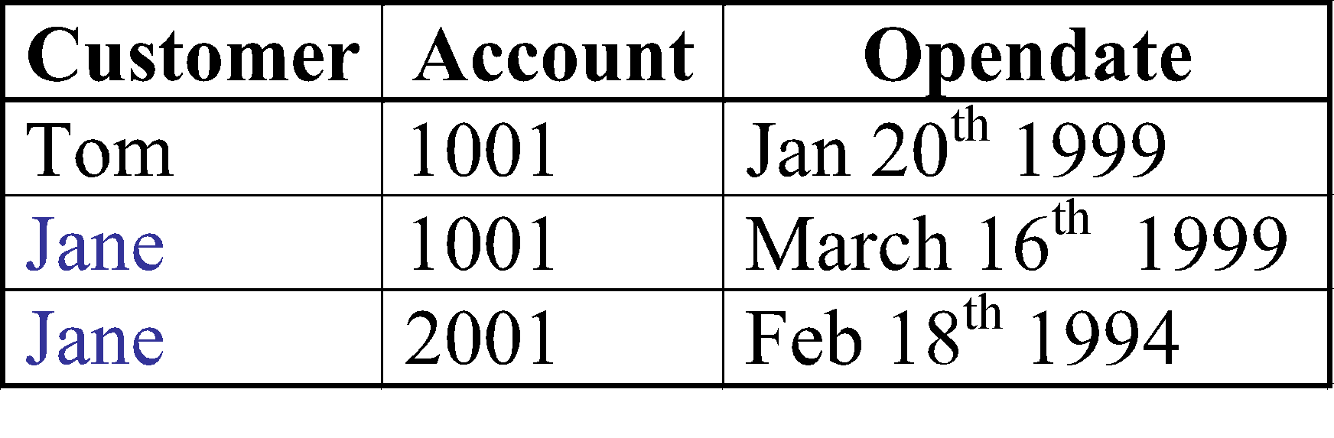
Many-to-many Relationship
customer
custacct
account
legal
opendate
Multiple customers can share an account
Many accounts may have one owner
(We use customer names as the ids.)
legal

Slide 56
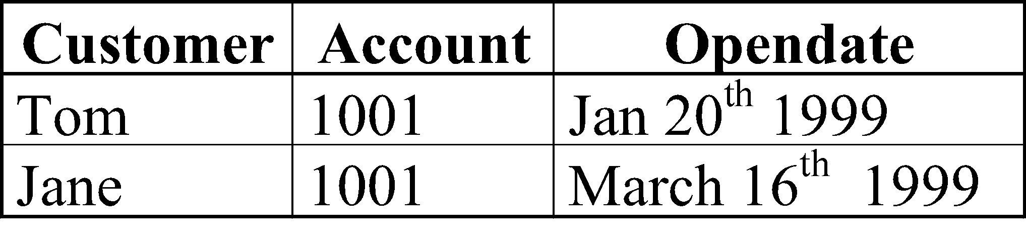
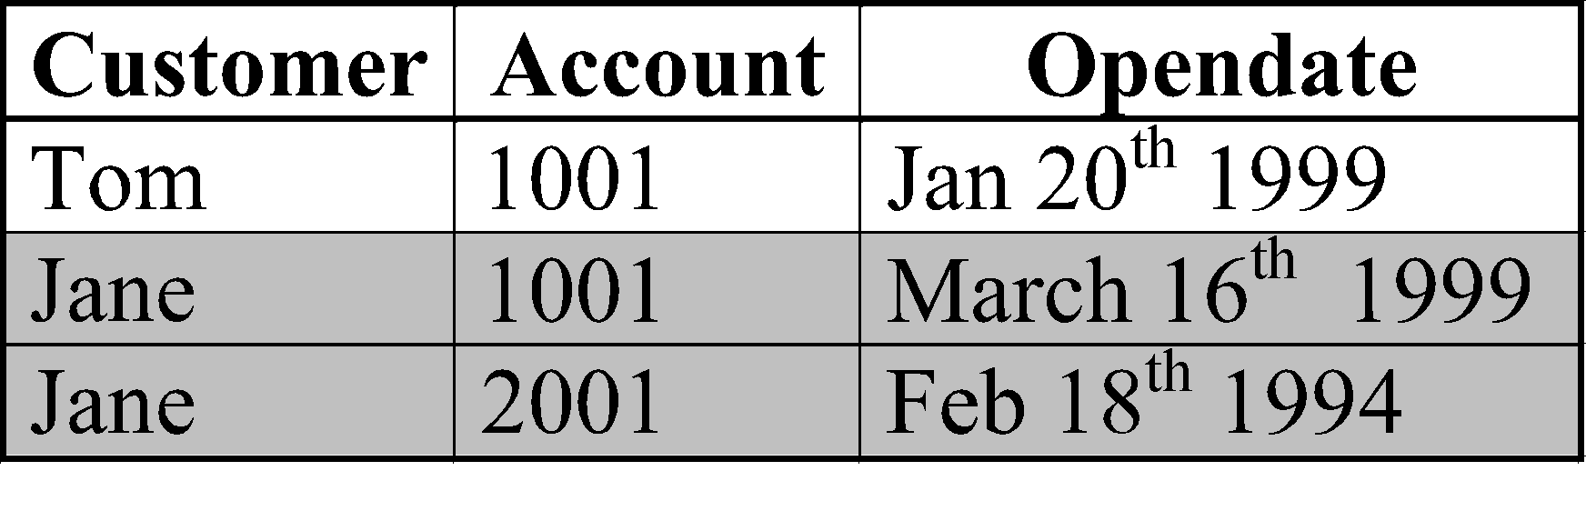
Many-to-One Relationship
customer
N
custacct
1
account
Illegal ☹
opendate
Multiple customers can share an account, but one customer can have only one account.
Represented by an arrow pointing to “one.”
Note: could have no account!
legal ☺

Slide 57
Many-to-One Relationship (cont)
customer
custacct
account
opendate
In a many-to-one relationship, relationship attributes can be repositioned to the entity set on the “many” side.
customer
custacct
account
opendate

Slide 58
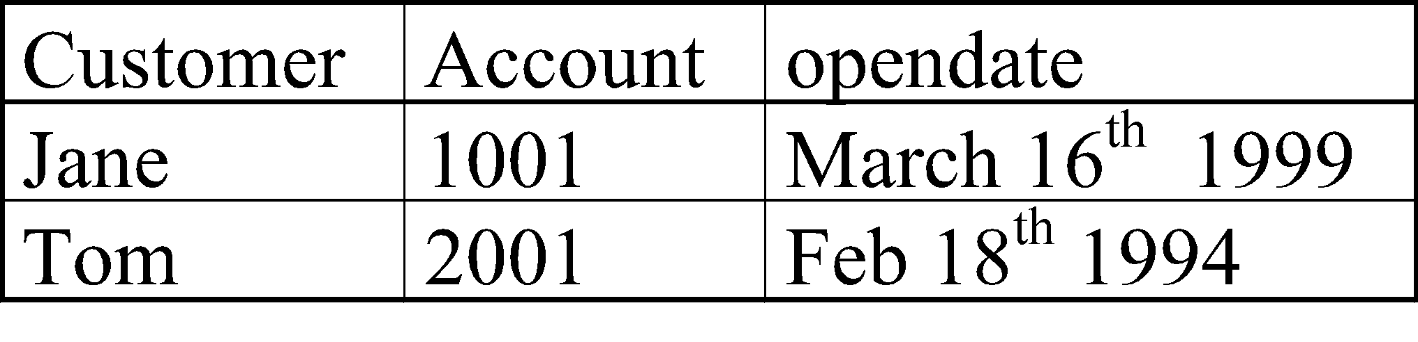
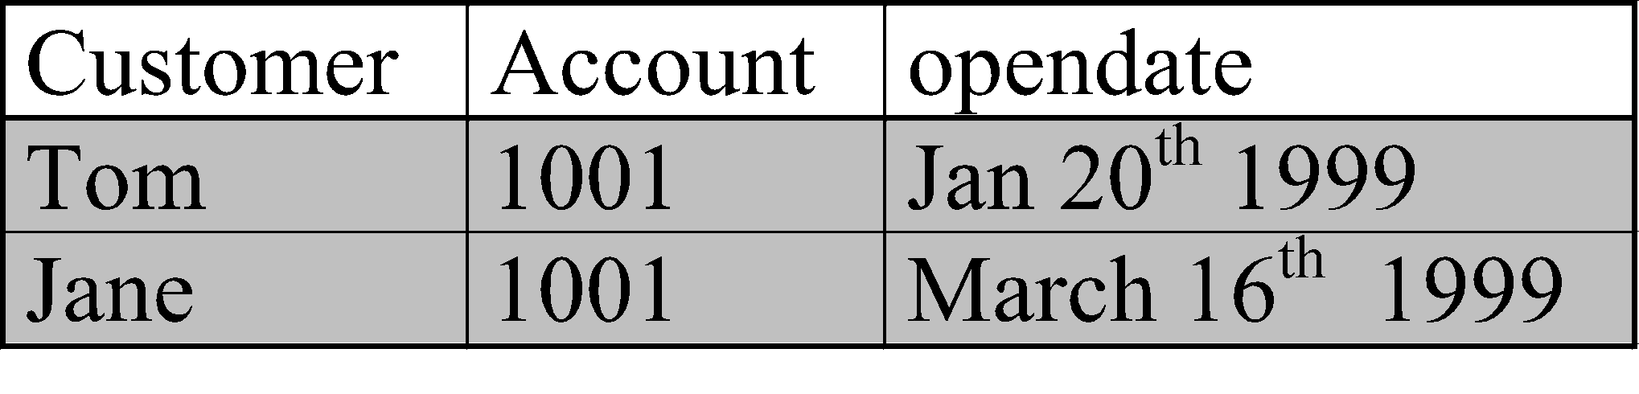
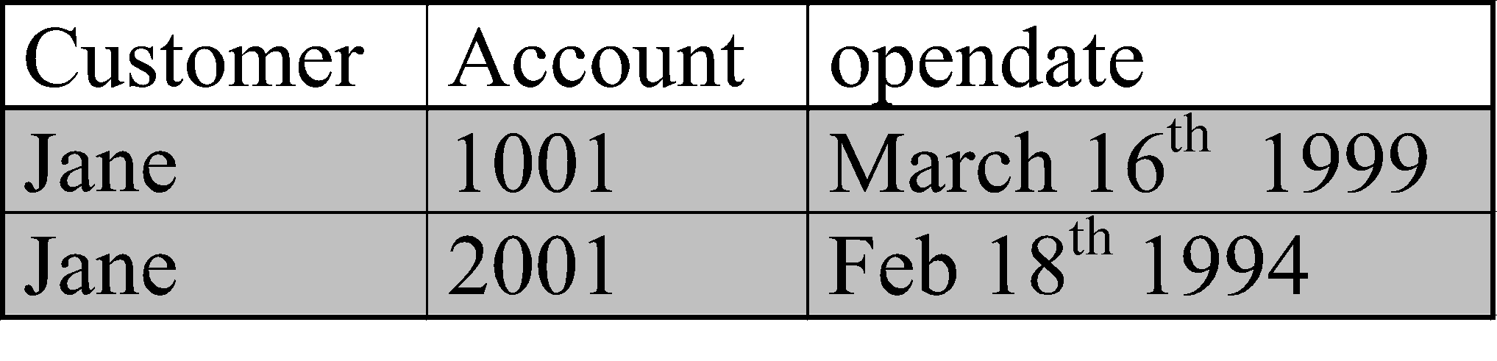
One-to-one Relationship
customer
custacct
account
opendate
Illegal
1 customer can have (at most) 1 account.
1 account can be owned by (at most) 1 customer
Relationship attributes “opendate” can be shifted to either entity set.
One-to-one relationship is considered as a special case of many-to-one relationship
Illegal
Legal

Slide 59
Participation Constraints
It is the participation of an entity set E in a relationship set R. It can be
- Total
- Partial
A B A B
Total
Partial

Slide 60
Weak Entity Sets
Weak entity sets: they do not have sufficient attributes to form a key.
They need to “borrow” attributes from other entity sets to form a key.
Example:
Transactions of different accounts could have the same trans#, so “trans#” cannot be a key
By borrowing attribute “number” from “account,” we have a key for “transaction.”
“Transaction” is a weak entity set related to accounts via log relationship.
number
balance
trans#
account
log
transaction

Slide 61
Weak Entity Sets (cont’)
A weak entity set depends upon (one or more) strong entity sets via a one-to-many relationship from whom they derive their key.
The “helper” entity set that provides the attributes is called the “owner” entity set.
A weak entity set may have a discriminator (or a partial key) that distinguish between weak entities related to the same strong entity
Key of weak entity set = key of owner entity set(s) + discriminator
number
balance
trans#
amount
account
log
transaction

Slide 62
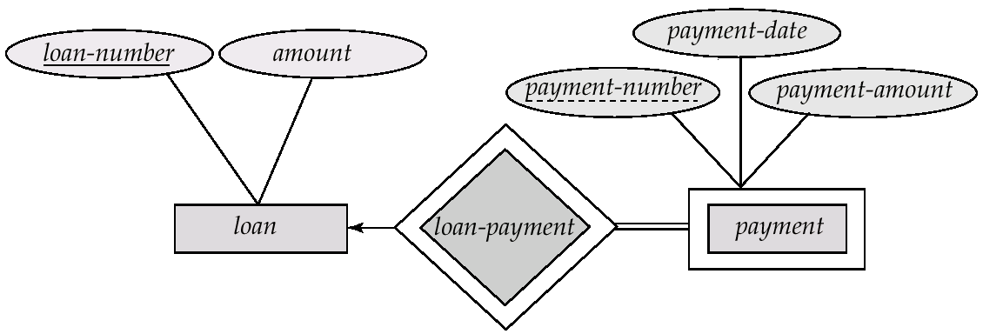
Weak Entity set

Slide 63
Strong entity set
An entity set that has a primary key is termed as strong entity set.

Slide 64
Subclass/Superclass Relationships
Reason: An ES may have members with special properties not associated with all ES members.
Example: Different accounts have different attributes.
Checking Account: overdraft amount,
Savings account: interest-rate.
Possible representations in ER:
Add an attribute “accountType”: a checking account has a value for the “overdraft” attribute. A savings account has a value for the “rate” attribute.
Problem: inconsistency; useless attributes; different accounts participate in different relationships.
Add two columns : IsCheckingAccount and IsSavingAcc:
The value for overdraft will be stored in IsCheckingAcc column.
And the interest_rate will be stored in IsSavingAcc column.
Problems : there will be many NULL values.

Slide 65
Subclass/Superclass Relationships
account#
accounts
balance
ISA
rate
savings
checkings
overdraft
The problems stated previously can be solved by using subclass/superclass relationships.
“Savings” and “checkings” are subclasses of the “account” ES.
“Accounts” is a superclass of savings and checkings ES’s.
An entity in a subclass must belong to the superclass as well.
Every savings/checking account is also an account.
Attribute Inheritance:
Subclasses inherit all attributes of the superclass.
Key of the subclass is the same as the key for the superclass.

Slide 66
Subclass/Superclass Relationships
Superclass and Subclass relationships arise during schema design due to the process of specialization and generalization
Specialization: process of classifying a class of objects into more specialized subclasses
E.g., start with an employee ES, then specialize it into different types of employees.
Generalization: Reverse of specialization. A process of synthesis of two or more lower-level ES to produce a higher-level ES.

Slide 67
Specialization
An entity set may include sub grouping of entities that are distinct in some way from other entities in the set.
For Instance, a subset of entities with in an entity set may have attributes that are not shared by all the entities in the entity set.
The process of introducing new characteristics to an existing class of objects to create one or more new classes of objects is called Specialization..

Slide 68
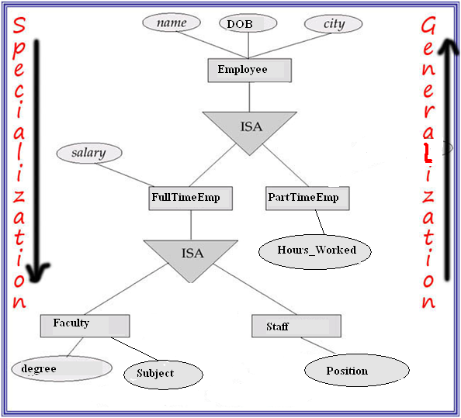
Specialization Example

Slide 69
Generalization
A bottom-up design process – combine a number of entity sets that share the same features into a higher-level entity set.
Generalization is the process of viewing objects as a single general class by concentrating on the general properties of the constituent sets while ignoring their differences.
Specialization and generalization are simple inversions of each other. They are represented in an E-R diagram in the same way.

Slide 70
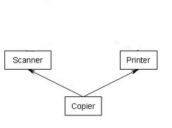
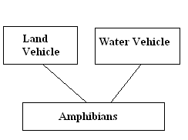
Multiple Inheritance
Subclass inherits all its attributes from its superclass.
If a subclass has 2 or more superclasses, then it inherits from all the superclasses.

Slide 71

Aggregation : Form 1
This represents “whole-part or a-part-of” relationship. This is represented by a hollow diamond followed by a line.
In this type of relationship, a child object does not exist without its parent. And a parent object may contain multiple instances of child object.
Let’s take an example of relationship between Department and Teacher. A Teacher object can not exist independently without the existence of any department. And if we delete any department, the teachers associated with that dept will also be deleted.

Slide 72
Another form of Aggregation
Form 2: It allows a relationship set to participate in another relation.
Express that “an employee works on a specific project possibly using some machines (could be 0).”
Works
employees
projects
machinery
Design 1: incorrect, since it requires each project to use tools.
work
employees
projects
using
machinery
“Design” 2: incorrect, since “relationships of relationships” are not permitted in ER!

Slide 73
Aggregation
work
employees
projects
using
machinery
Aggregation is an abstraction through which relationships are treated as higher-level entities.
Treat the relationship set “work” and the ES’s “employees” and “projects” as a higher-level ES -- an aggregate entity set.
Permit relationships between aggregate entity sets and other entity set.
To create tables out of it : Create a table consisting Primary key of the aggregated relationship & the primary key of the associated entity.

Slide 74
Draw E-R Diagram
Supplier(S_ID, Sname, Status, City)
Parts (P_ID, Pname, Color, Weight, City)
Projects(Pr_ID, Pr_name, City)
Supplied_Quantity(S_ID, P_ID, Pr_ID, Quantity)
Draw an E-R Diagram.

Slide 75
E/R Design Principles
Keep the same schema: Schemas should not change often. So store frequently changing information as instances.
currently each project consists of 10 members. Since later projects may have more or less employees, do not hard code the 10 employees as 10 attributes of the project entity
Avoid redundancy: schemas should prevent representing the same facts multiple times.
An attribute/relationship is redundant if deleting it does not result in a loss of any information
Redundancy may cause:
wastage of space
application programming more difficult: need to update all instances of a fact to avoid inconsistency of database
Consistent and clear names for attributes, entities, and relationships

Slide 76
Redundant Attributes
dept #
mgr start date
start date
ssno
departments
manages
employees
Redundant attribute: Managers start date are stored twice.

Slide 77
Redundant Relationship
supplies
suppliers
is-customer-of
items
used-by
projects
The fact that a project is-customer-of a supplier can be derived from the relationships “used-by” and “supplies”:
A project is-customer-of a supplier if the supplier supplies an item used by the project.

Slide 78
Case Study 1
Design a DB representing cities, counties, and states in the US:
For states, record the name, population, and state capital (a city).
For counties, record the name, the population, and the located state.
For cities, record the name, the population, the located state and the located county.
Uniqueness assumptions:
Names of states are unique.
Names of counties are unique within a state (e.g., 26 states have Washington Counties).
Cities are unique only within a state (e.g., there are 24 Springfields among the 50 states).
Some counties and cities have the same name, even within a state (e.g., Los Angeles).
All cities are located within a single county
Notes:
9

Slide 79
Design 1: bad
Co. Popu.
Co. name
Popu.
cities
Located
states
name
Ci. Popu.
Ci. name
capital
Problem: County Population is repeated for each city.

Slide 80
Design 2: good
Co. Popu.
Co. name
Popu.
name
counties
Located
states
Belongs-to
cities
capitals
Ci. Popu.
Ci. name
The population of a county is derived from those of its cities.

Slide 81
Case Study 2
Design a DB consistent with the following facts.
Trains are either local trains or express trains, but never both.
A train has a unique number and an engineer.
Stations are either express stops or local stops, but never both.
A station has a unique name and an address.
All local trains stop at all stations.
Express trains stop only at express stations.
For each train and each station the train stops at, there is a time.
Notes:
13

Slide 82
Design 1: bad
number
type
time
name
addr
trains
StopsAt
stations
engineer
type
Problem: does not capture the constraints that express trains only stop only at express stations and local trains stop at all local stations
Notes:
15

Slide 83
Design 2: good
number
engineer
train
time
name
address
ISA
local trains
StopsAt2
stations
ISA
express trains
time
StopsAt1
express stations
local stations
Notes:
16

Slide 84
Case Study 3
An accounting firm wants a simple HR application that will help it to keep track of its Employees, their positions (or designations), allowances (or perks), salary scales, and which departments have those positions. The application must keep track of all the positions in the firm, the employees appointed to fill up those positions, the allowances granted to these positions, the salary scales for these positions, and the departments having these positions.

Slide 85

Dr. Edgar F. Codd (1923-2003)
Codd completed his PhD at the University of Michigan in 1963, and presented a thesis on the topic of a self-reproducing computer consisting of a large number of simple identical cells, each of which interacts in a uniform manner with its four immediate neighbors.
Codd reported this work in a book entitled Cellular Automata published by Academic Press in 1968.

Slide 86
12 Codd's Rules

Slide 87
Rule 1 : The Information Rule
All data should be presented in table form.
Rollno | Name | Age | college
10 | Rohit | 20 | Bv
11 | Rahul | 21 | Abes
12 | Amit | 22 | Jss
13 | Simran | 23 | its

Slide 88
Rule 2 : Guaranteed Access Rule
All data should be accessible without ambiguity.
This can be accomplished through a combination of the table name, primary key and column name.

Slide 89
Rule 3: Systematic treatment of null values
A field should be allowed to remain empty. This involves the support of null value, which is distinct from an empty string or a number with a value of zero.
Most database implementations support the concept of a not –null field constraint that prevent null values in a specific table column.

Slide 90
Rule 4: Dynamic on-line catalog based on the relational model
A relational database must provide access to its structure through the same tools that are used to access the data.
This is usually accomplished by storing the structure definition with in special system tables.
These tables are created owned and maintained by the DBMS. They can be accessed by the users in the same manner as ordinary tables, depending on the user’s privileges.

Slide 91
Rule 5 : Comprehensive data sub-language Rule
The database must support at least one clearly defined language that include functionality for data definition, data manipulation, data integrity and data transaction control.
All commercial relational databases use forms of standard SQL( structure Query Language) as their supported comprehensive language.

Slide 92
Rule 6 : View updating Rule
Data can be presented into different logical combinations called views.
Each view should support the same full range of data manipulation that has direct access to a table available.
In practical, providing update and delete access to logical views is difficult and is not fully supported by current database.

Slide 93
Rule 7 : High-level Insert, Update and Delete
Data can be retrieved from a relational database in sets constructed of data from multiple rows and multiple tables.
This rule states that insert, update, delete operations should be supported for any retrievable set rather just for a single row in a single table.

Slide 94
Rule 8 : Physical data independence
The user is isolated from the physical method of storing and retrieving information from the database.
Changes can be made to the underlying architecture ( hardware, disk storage methods) without affecting how the user accesses it.

Slide 95
Rule 9 : Logical Data Independence.
How the data is viewed should not be changed when the logical structure (table’s structure) of the database changes.
This rule is difficult to satisfy.
Most databases rely on strong ties between the data viewed and the actual structure of underlying tables.

Slide 96
Rule 10 : Integrity Independence
SQL should support constraints on user input that maintain database integrity.
At a minimum, all databases do preserve two constraints through SQL.
Primary key should be not null and unique.
If a foreign key is defined in one table, any value in it must exist as a primary key in another table.

Slide 97
Rule 11 : Distribution Independence
A user should be totally unaware of whether or not the database is distributed ( whether parts of the database exist in multiple locations).
A variety of reasons make this rule difficult to implement.

Slide 98
Rule 12: The Non subversion rule
There should be no way to modify the database structure other than through the multiple row database language( SQL).
Most databases today support administrative tools that allows some direct manipulation of the data structure.

Slide 99
Short Questions:
Q.1 What is data independence?
Q.2.What do you mean by DBMS?
Q.3What is the difference between Generalization and specialization?
Q.4 Describe the characteristics of DBMS.
Q.5 Explain all components of E-R Diagram.
Q.6 What is role of keys in DBMS and explain how many types of keys are there?

Slide 100
Long Questions:
Q.1 Describe 3-level of abstractions of DBMS.
Q.2 Differentiate between physical and logical data independency.
Q.3 Discuss all 12 rules of Dr. E.F. Codd’s.
Q.4 What is data model? Discuss various data models available in DBMS.
Q.5Differentiate between weak and strong entity sets with example.
Q.6 What is a DBMS? How does it differ from a
conventional file system?

